Slide 1
EC2 Assignment - 2
Create an Instance in us-east-1 (N. Virginia) region with Linux OS and manage the requirement of web servers of your company using AMI.
Replicate the instance in us-west-2 (Oregon) region
Build two EBS volumes and attach them to the instance in us-east-1 (N. Virginia) region.
Delete one volume after detaching it and extend the size of other volume.
Take backup of this EBS volume.

Slide 2
Solution: Question -1
Step 1:
→The first step ism same which is shown in the first assignment step.
Question -2
Step 1:
→Replicate the instance in us-west-2 (Oregon) region.

Slide 3
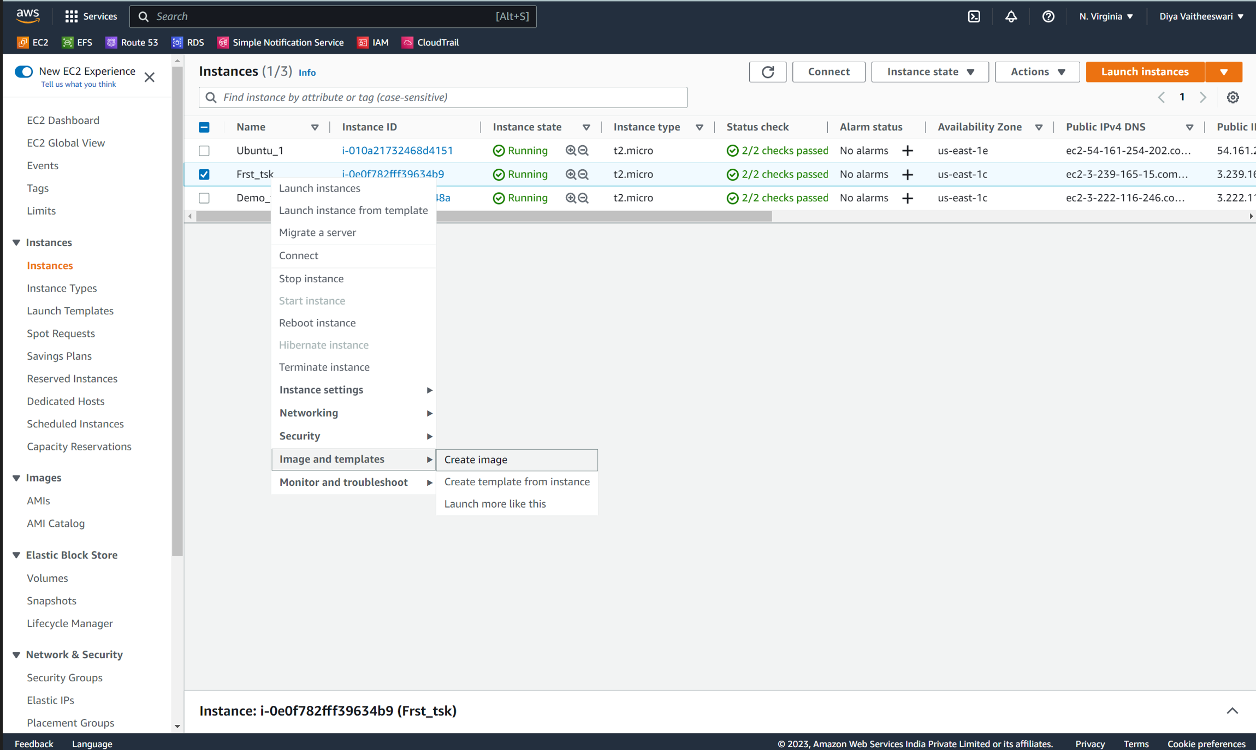

Slide 4
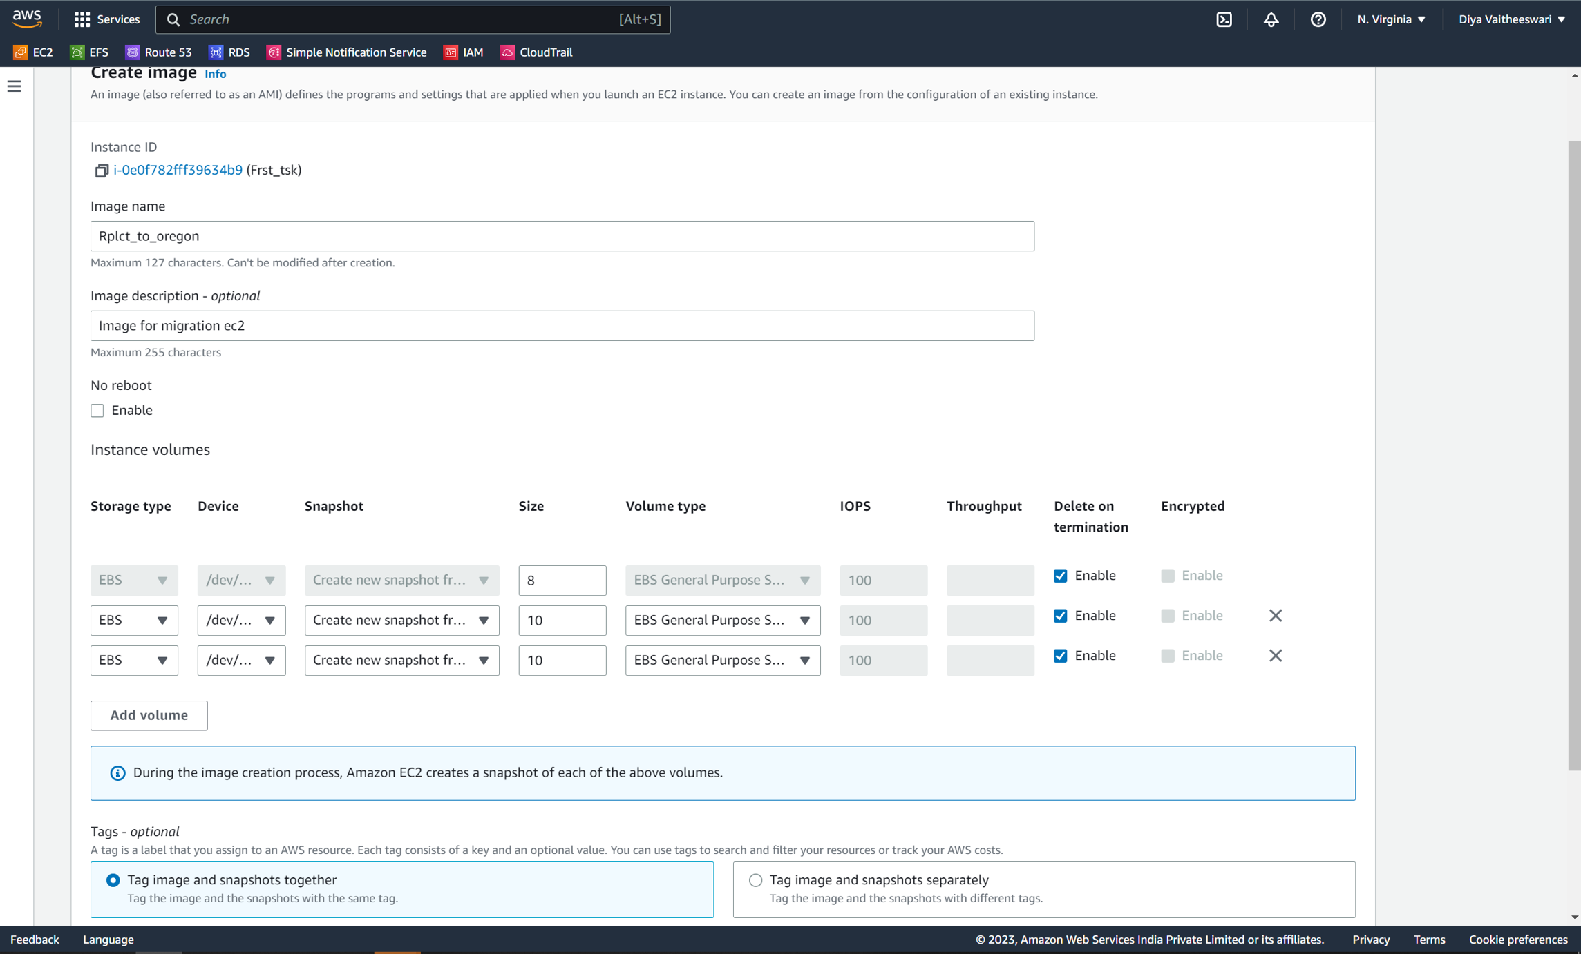

Slide 5
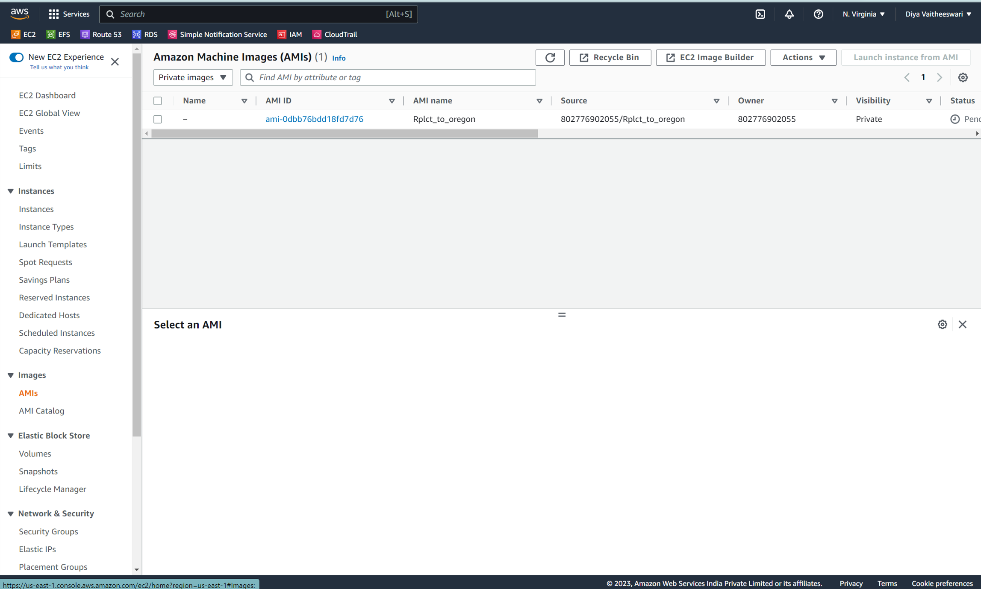

Slide 6
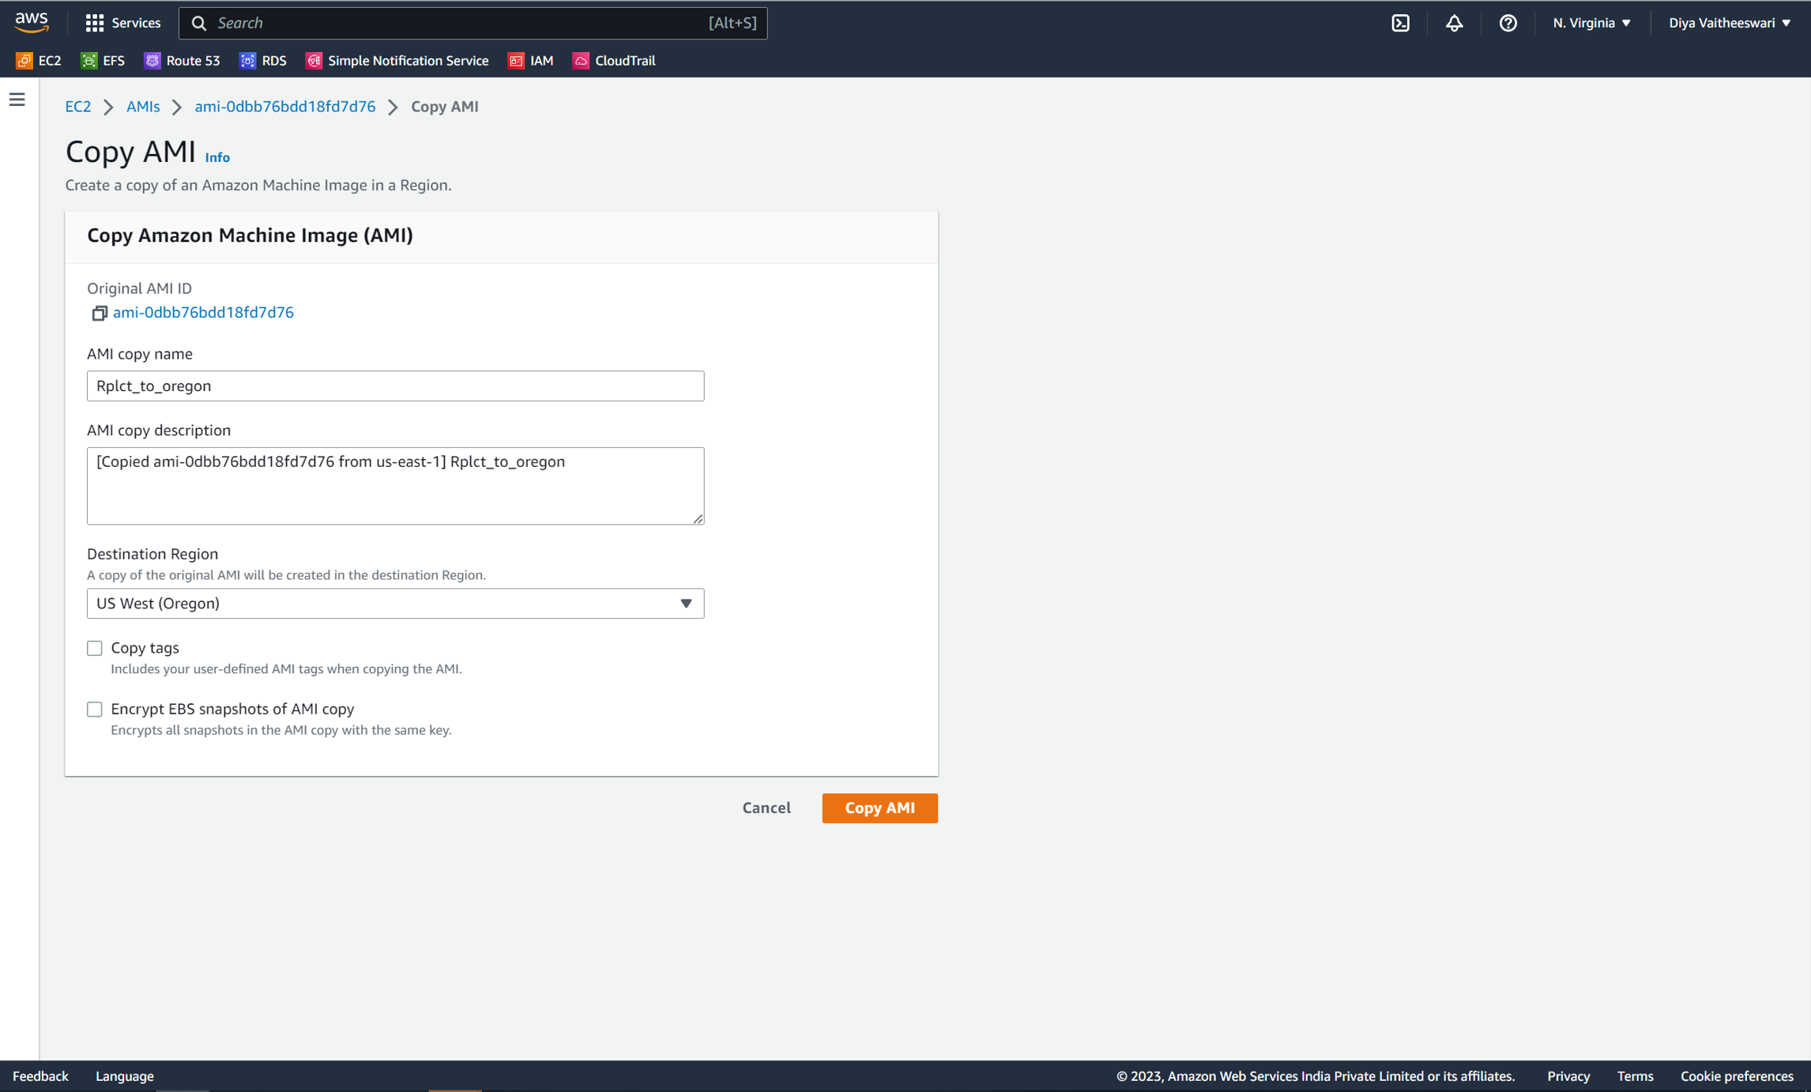

Slide 7
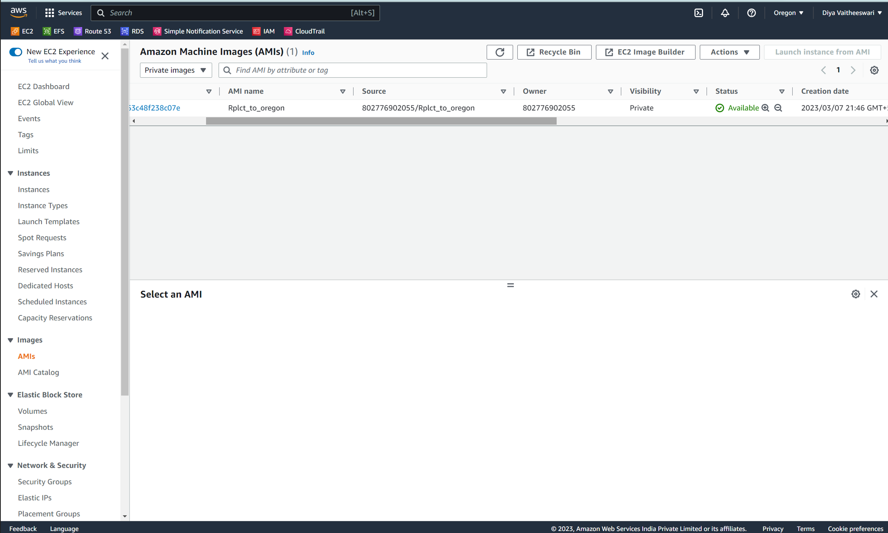

Slide 8
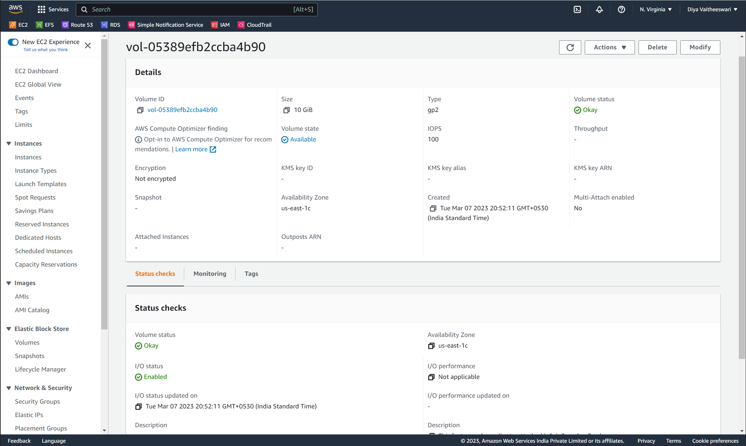
Question -3 : →Build two EBS volumes and attach them to the instance in us-east-1 (N. Virginia) region.
Step -1 :
→Build the EBS volume.

Slide 9
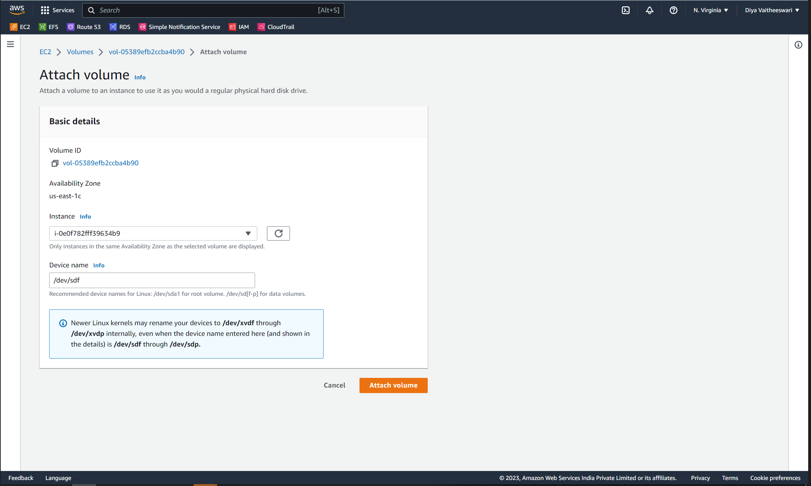
Step -2: Take a snapshot and then attach the volume in the existing instance and existing region.

Slide 10
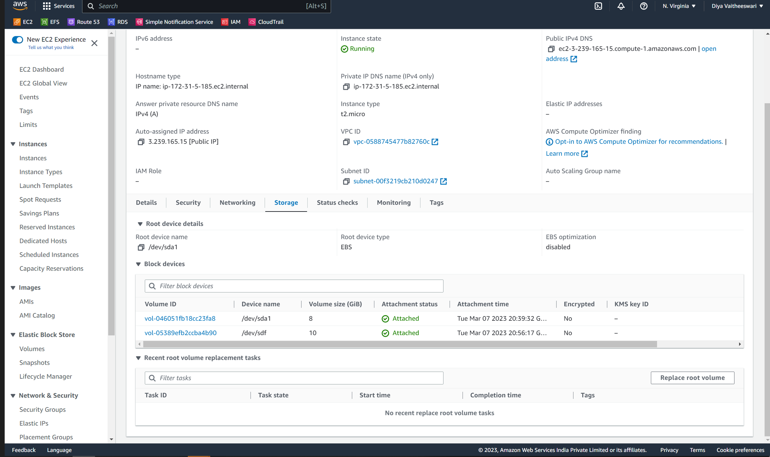

Slide 11
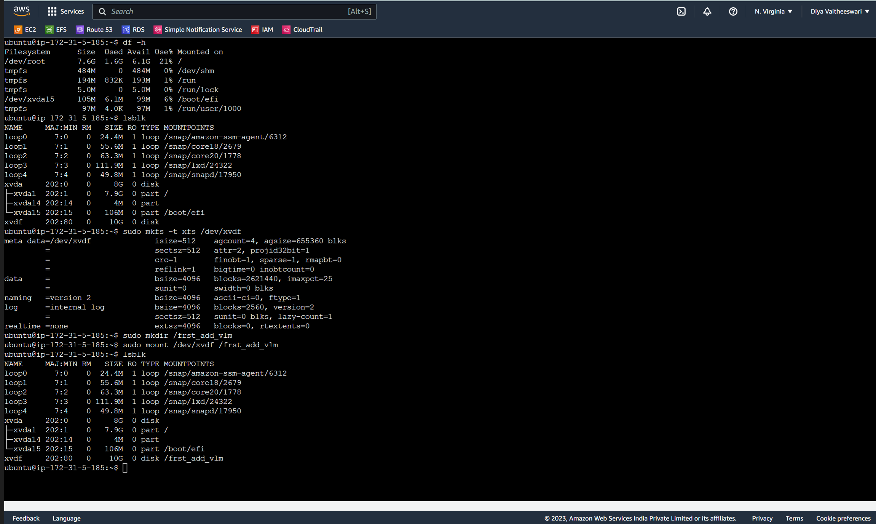
Step -3 : Mount the volume in the existing instance.

Slide 12
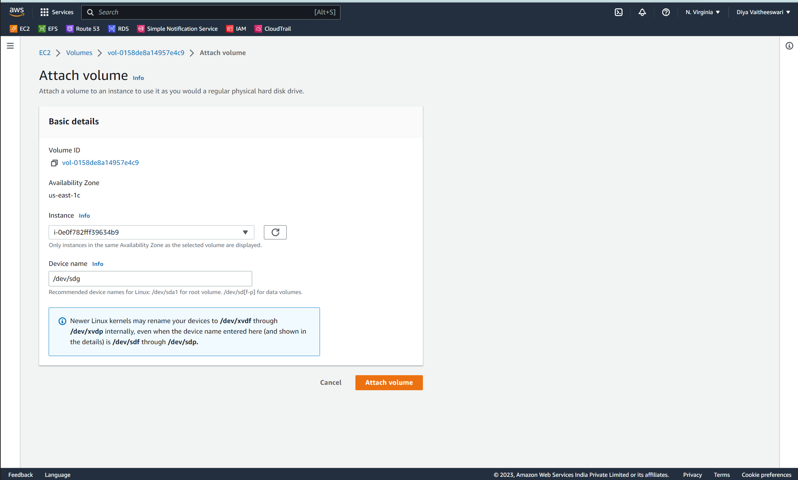
Step - 4: create an another EBS volume and attach the existing instance.

Slide 13
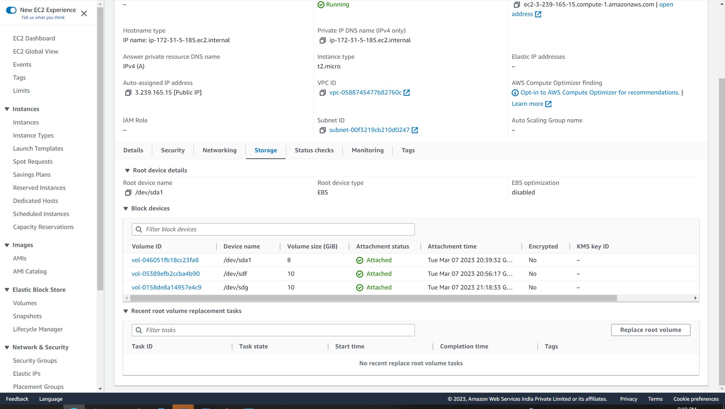

Slide 14
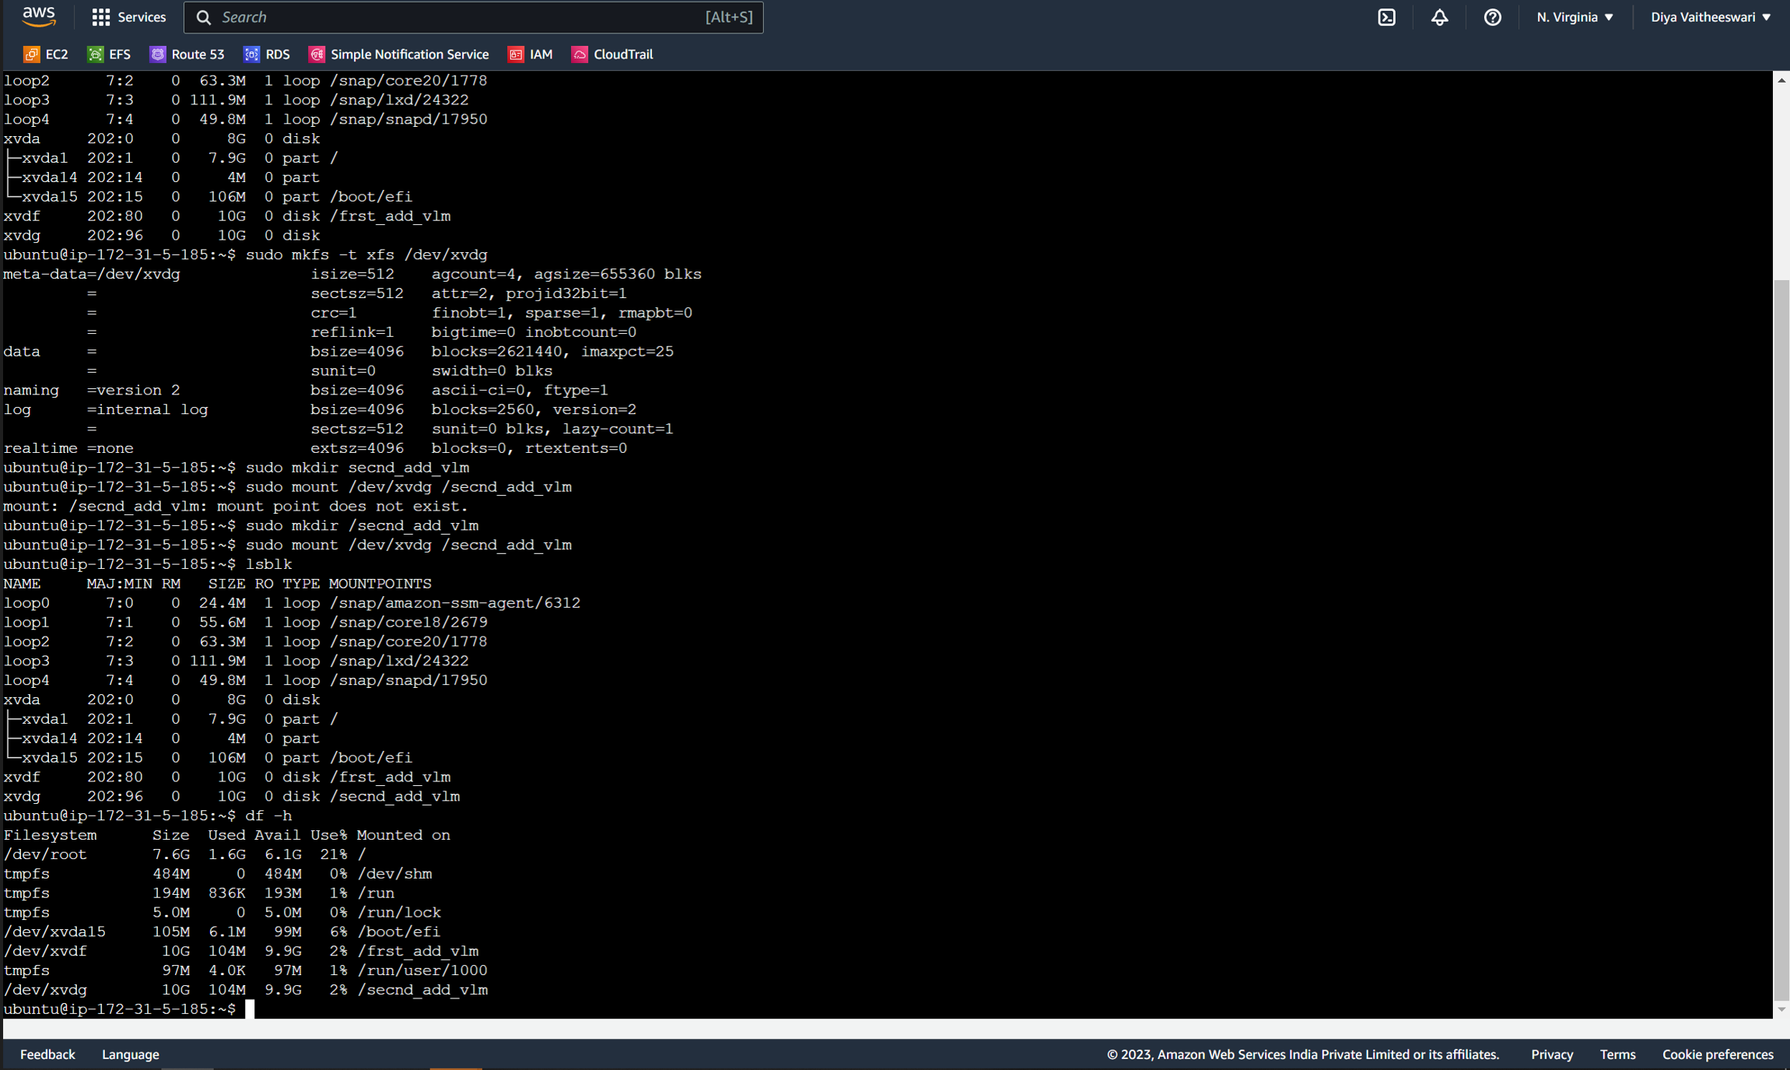

Slide 15
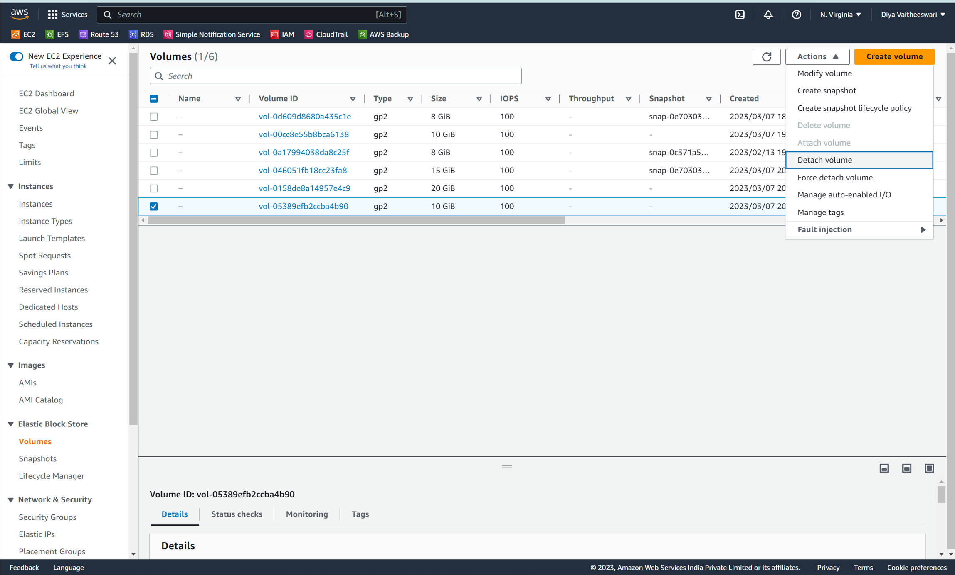
Question-4: Delete one volume after detaching it and extend the size of other volume.
Step -1 :
Detach the volume from existing instance.

Slide 16
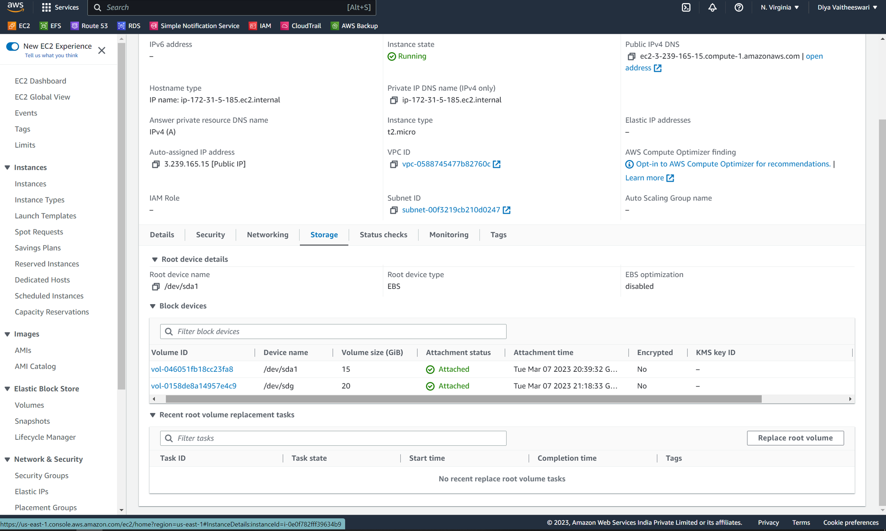

Slide 17
